Slide 1
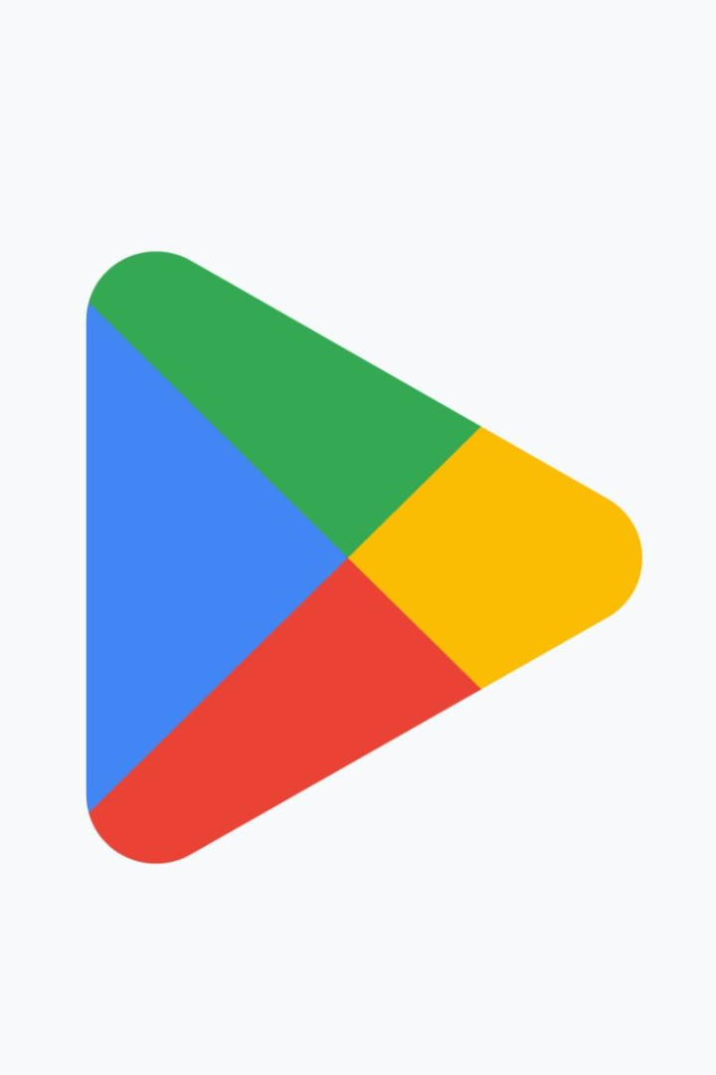

Capstone Project
Google Play Store App Review Analysis
By
Vibhuti Gupta
Rudraashish Sen Gupta

Slide 2



Introduction
Play store is an Android Market serves as the official app store for certified devices running on the Android Operating system. Developed and Operated by Google, launched on 6th March, 2012.
Approximately 3.48 million apps are in the Play store. Play store apps have their own features such as Ratings, Reviews, Size and more. From the problem statement given, we should analyze the given database and should come up with the key factors that increased the number of users, long term usage etc., the objective of this project is to deliver insights to understand customer demands better and thus help developers to popularize the product.

Slide 3




WHY ANALYZE THE GOOGLE PLAY STORE?
Mobile App Market is set to grow 20% by 2023
Android Apps comprise 90% of the Mobile App Market
What makes an App popular? Can we predict how popular it’s going to be?
What are some interesting patterns in user behavior related to app usage & feedback?

Slide 4


Problem Statement
Two datasets are provided, one with basic information (play store Data.csv and the other with user reviews (User Reviews.csv) for the respective app.
We must examine and evaluate the data in both datasets in order to identify the important characteristics that inﬂuence app engagement and success.
So, what factors inﬂuence an app's success?
An app is said to be successful if it has:
A high average user rating
A good number of positive reviews
A good number of monthly average users
High revenue per customer and so on.

Slide 5

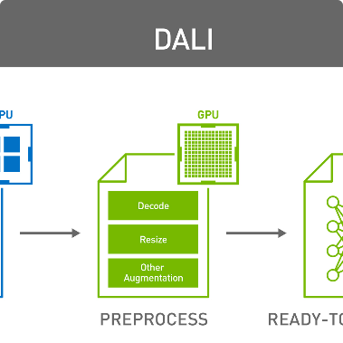

Data Collection and Preprocessing
Data Collection
Data Preprocessing
Data Validation
We scraped data from the Google Play Store API and performed data cleaning to remove missing values and outliers.
We standardized and transformed variables, and created new features to enable further analysis.
We visually inspected the data to ensure accuracy and performed statistical tests to validate our findings.

Slide 6
Correlations and Relationships
Size vs. Installs
We identified that app size has a negative correlation with installs, meaning that users prefer smaller apps that are easier to download and use.
1
2
3
Price vs. Rating
Reviews vs. Rating
We found that price has a weak positive correlation with rating. This implies that users are willing to pay more for higher quality apps.
Our analysis revealed that apps with a higher number of reviews tend to have higher ratings. This suggests that user feedback is important for app success.

Slide 7
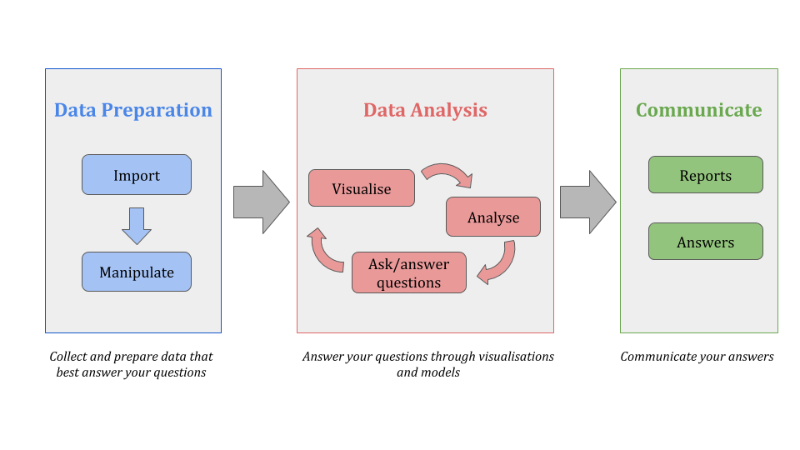
Flowchart And EDA Process:

Slide 8
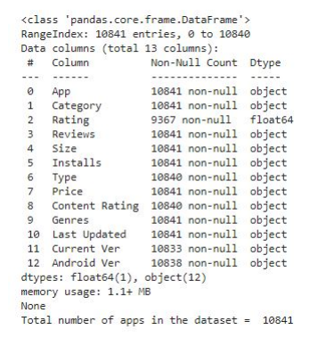
Attributes in Google Play store Data

Slide 9
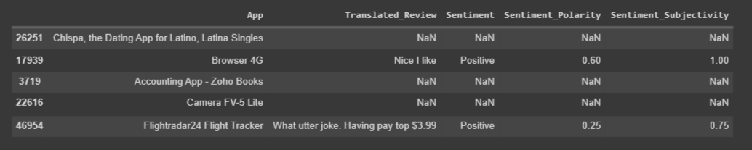
Attributes in User reviews

Slide 10
Descriptive Statistics and Visualizations
Rating Distribution
Installs by Category
App Size
We discovered that gaming apps have the highest number of installs, followed by entertainment and productivity apps.
We found that the majority of apps in the store have a rating between 3 and 4.5 stars.
We identified that the median app size is around 20MB and that games tend to be larger than other types of apps.
User Review Text Sentiment
We used natural language processing techniques to analyze user reviews and found that the majority of reviews have a positive sentiment.

Slide 11
Data Cleaning and Manipulation:
In the size column, converted KBs→MBs
02
From the Installs and Price columns, changed ‘$’, ‘,’, ‘+’ to an empty string.
Dropped duplicate rows from both the datasets
01
03
04
In ‘Rating’ column, replaced the null values with the mode.

Slide 12
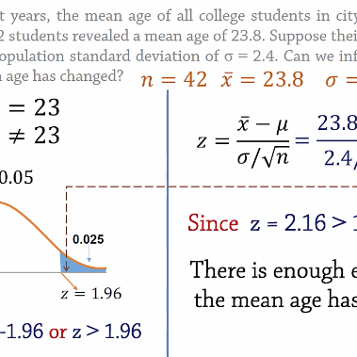


User Review Sentiment vs. Ratings
App Category vs. Ratings
Free vs. Paid Apps
We conducted an ANOVA test to compare the ratings of different app categories and found that games have a significantly higher rating than other categories.
We tested the null hypothesis that there is no difference in ratings between free and paid apps and found that paid apps have a significantly higher rating.
We used linear regression to analyze the relationship between user review sentiment and ratings and found a positive correlation.

Slide 13
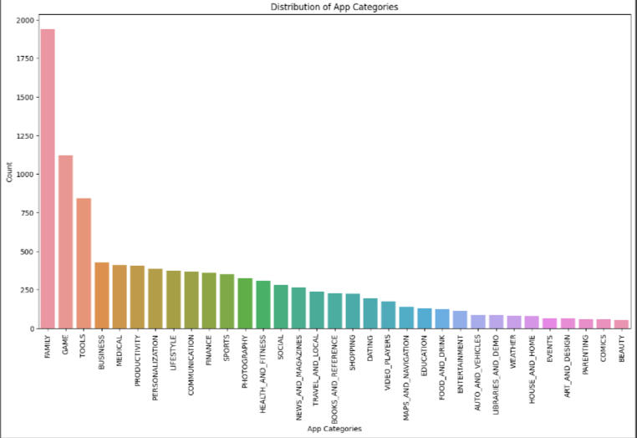
Let’s explore app categories!
Most of the apps are under FAMILY & GAME category and least are of Comics & BEAUTY Category.

Slide 14
Top-Rated Apps on Google Play Store
Mobile Apps 📲
Games 🎮
Entertainment 🎬
WhatsApp Messenger
PUBG MOBILE
Netflix
Instagram
Candy Crush Saga
YouTube
Facebook
8 Ball Pool
Disney+
TikTok
Brawl Stars
Amazon Prime Video

Slide 15
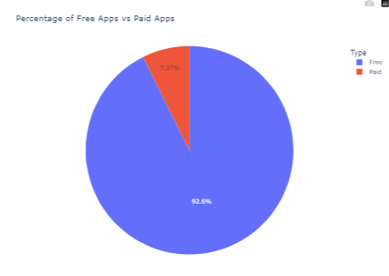
How many apps are paid?
From the above pie chart, we can conclude 92.6% apps on google play store are free.
Even from the 7.4% of paid apps, most of the apps has price range under 100 dollars.
So less the price
More are the installs!!

Slide 16
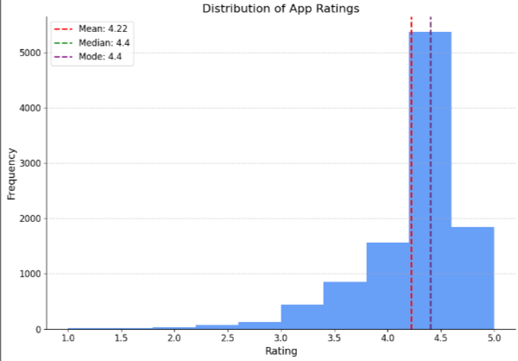
Now let’s see how ratings are performing!
We can observe that average rating across all app categories is 4.217.
A small spike at rating 1 emphasizes that a few apps has been rated poorly and hence the subsequent installs are affected.

Slide 17
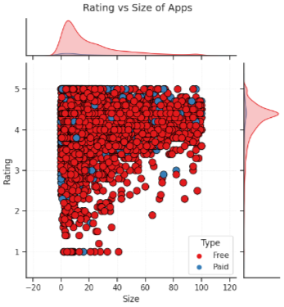
Does size of an app affect it’s rating?
People generally prefer apps with less size due to data and/size constraints. As the size of an app increases, it's rating decreases.
Surprisingly, there are few apps whose size is close to 100 MBs but still has 4/5 stars as a review. Though this number is less, we can't ignore a fact that the rating also depends upon the content that the app is serving.
There are many apps that are smaller in size and have very good rating.

Slide 18
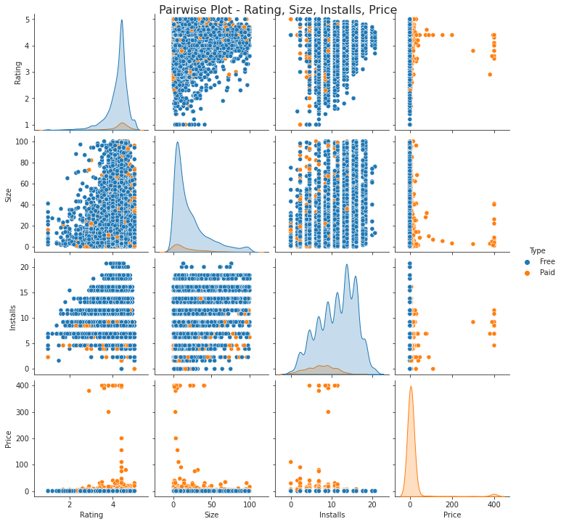
Bivariate Analysis
Here, we are exploring 2 columns at the same time, for the purpose of determining the empirical relationship between them.

Slide 19
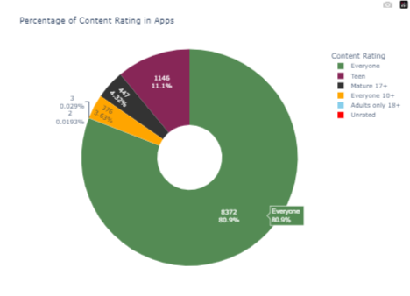

Let’s explore content rating!
Mostly 90% of total apps are targeting audience in every age group and hence they are available for everyone.
Very few(less then 500 apps) are catering to only adult population i.e. Mature 17+

Slide 20
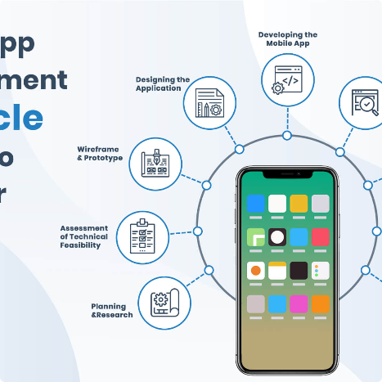

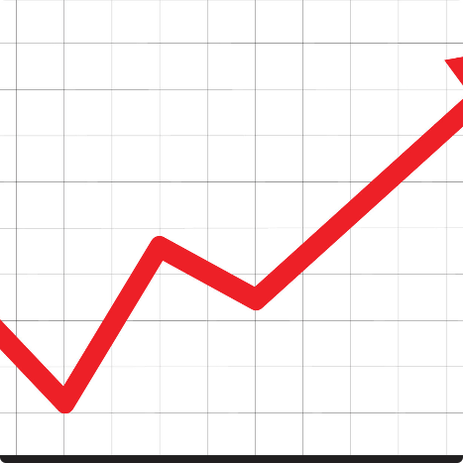
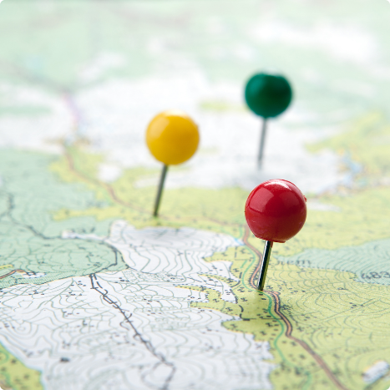
Understanding User Preferences and Trends
Staying Ahead of the Curve 🔝
Segmenting Users 🎯
Measuring Impact 📈
Global Outlook 🌍
Identify emerging trends to capitalize on new opportunities and remain competitive in the marketspace.
Use review data to categorize users based on demographics and preferences, enabling personalized services and targeted marketing.
Track product and marketing effectiveness by comparing ratings and reviews before and after making changes.
Analyze review data across countries to tailor approaches to local preferences, obtaining greater international success.

Slide 21
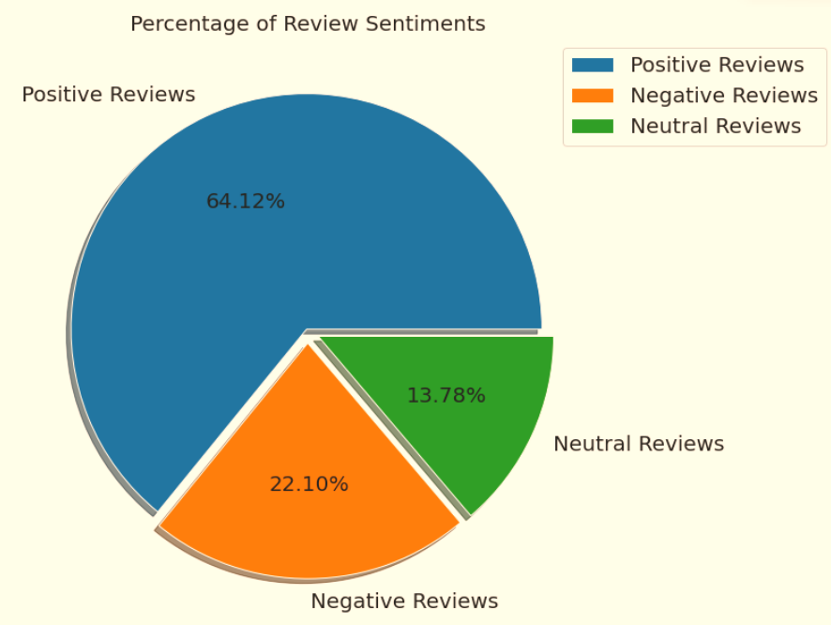
Percentage of Review Sentiments
The number of Unique Apps from Play store and User reviews merged dataset are 816.
From Sentiment column, 64% are Positive, 22% are Negative and 14% are Neutral values.

Slide 22
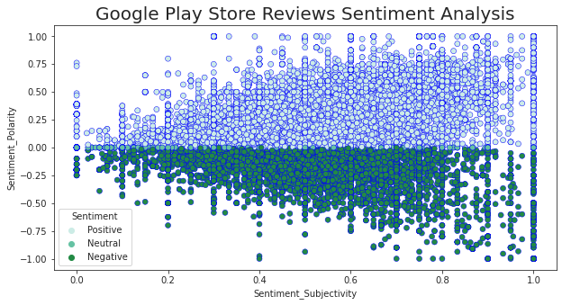
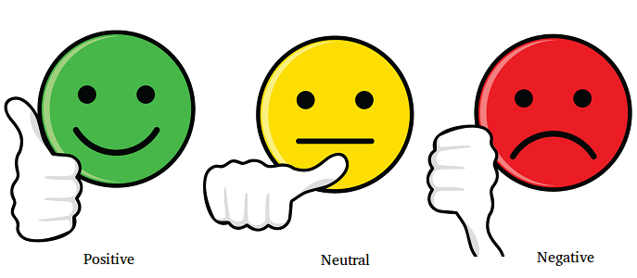
How does sentiment polarity and sentiment subjectivity are linked?
As we can observe from the above graph that sentiment subjectivity mostly lies in the range of 0.5 to 0.8. It means, people are giving reviews more opinion and experience based rather than facts.
Sentiment subjectivity is mostly scattered around - 0.5 to 0.75 this shows that polarity is not always proportional to sentiment subjectivity but in maximum number of cases it shows a proportional behavior.

Slide 23
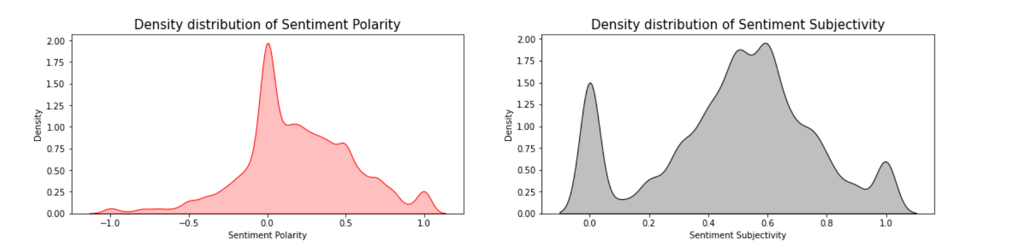
Sentiments
The polarity score lies in the range of [-1,1]. Here, we can see from our calculations and the Sentiment Polarity Density distribution graph that the Mean Sentiment Polarity Score is 0.18 which resembles a good average sentiment score(Majority of the users liking the apps).
The subjectivity is a float within the range [0.0, 1.0] where 0.0 is very objective and 1.0 is very subjective. As per our analysis and plotted graph, the Mean Sentiment Subjectivity Score is 0.49. That means around 50% users are sharing personal opinion while others 50% are just sharing the factual information in reviews.

Slide 24
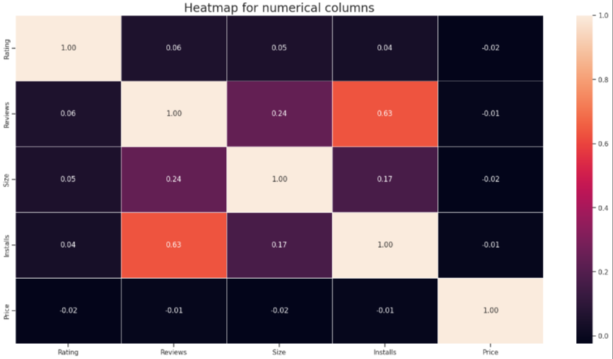
How Size, Reviews, Installs and Price of apps are correlated?
Positive correlation between the Reviews and Installs column i.e. (0.63).
While Price and Ratings share negative correlation i.e. -0.019.

Slide 25
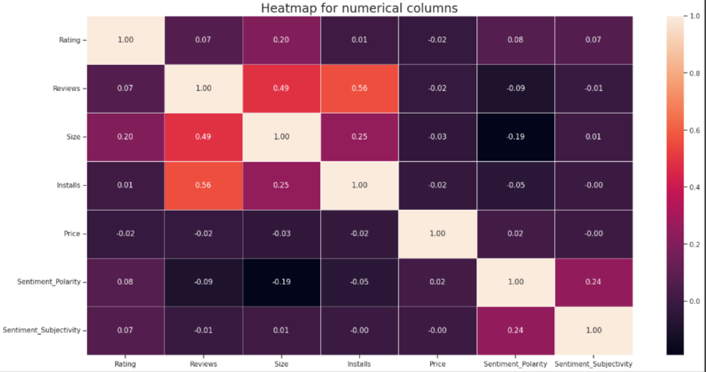
Let’s see how both the data sets are related!
Positive correlation between the Ratings and Reviews= 0.069.
Negative correlation between the Size and Sentiment Polarity = -0.19
Negative correlation between the Price and Sentiment subjectivity =
-0.00058

Slide 26

So let’s talk about the challenges that we faced:
One of the major challenge was to clean the datasets as a lot of scattered information was present especially in the 1st data set.
Handling the error, duplicate and NaN values in the dataset.
To draw meaningful insights, we had to design multiple visualizations like scatterplot, jointplot etc. without compromising the results and trends.
To overcome above challenges, we followed:
AlmaBetter Class material
Pandas and Numpy libraries
Stack overflow
YouTube

Slide 27

Limitations and Future Directions
1
Data Limitations
2
Future Research
Our analysis used a limited dataset that may not be representative of the entire app market.
Future research could focus on understanding the impact of app updates and reviews on long-term app success.
3
Methodological Improvements
We could improve our analysis by using more advanced statistical techniques and machine learning algorithms.

Slide 28
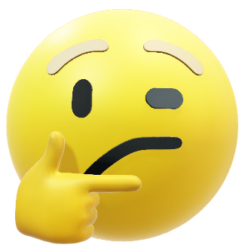
Let’s do some predictions!
Now that we have analyzed out datasets and drawn meaningful insights out of them, let’s see if we can ‘predict’ a perfect app!!
It's good to develop a free app that consumes less disk space and family and lifestyle categories can be aimed for more profit.
People tend to download more if apps have more reviews.
People follow apps with regular updates.
The category GAME is a potential unsaturated space for app developers. The segment is expected to grow 1.7 times faster than the rest of the market and surpass $136 billion in revenues in 2022.

Slide 29
Conclusion and Key Takeaways
Conclusion
Key Takeaways
Our analysis revealed that app ratings, user reviews, and app category are key factors that drive app success. Paid apps tend to have a higher rating than free apps, and games are the most popular category of apps.
High-quality apps tend to have higher ratings
User reviews play an important role in app success
Paid apps may be perceived as more valuable by users
Games are a popular category with high demand

Slide 30


